Slide 1
ANSWER BIA SQL STARTER TEST
BENEDICTA RAFENSCA MERRY CHRISTA
BUSINESS INTELLIGENCE ANALYST
WAVE 13

Slide 2
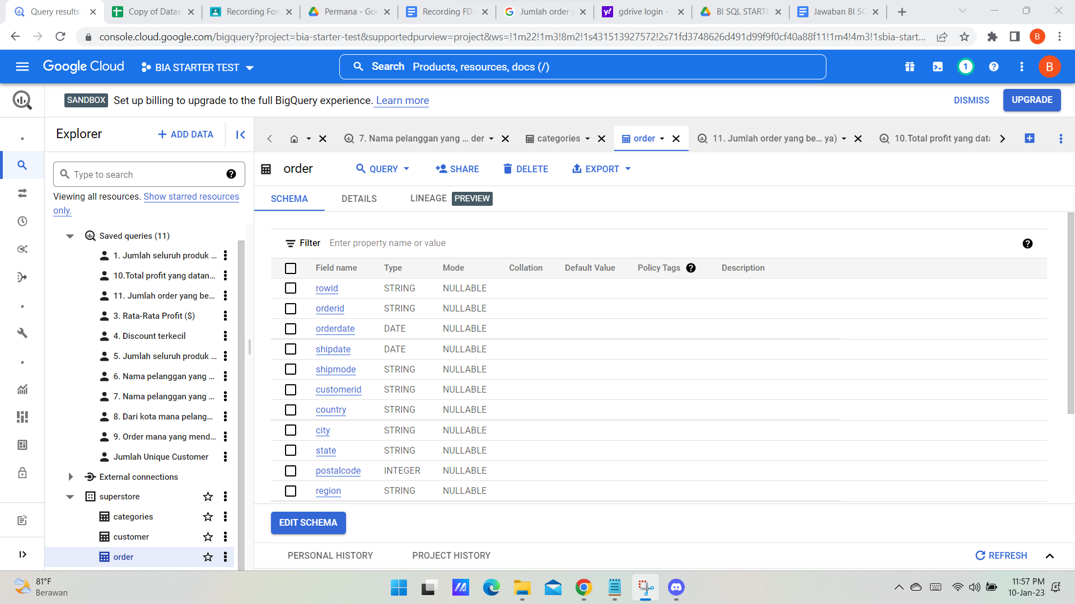
Tabel Order

Slide 3
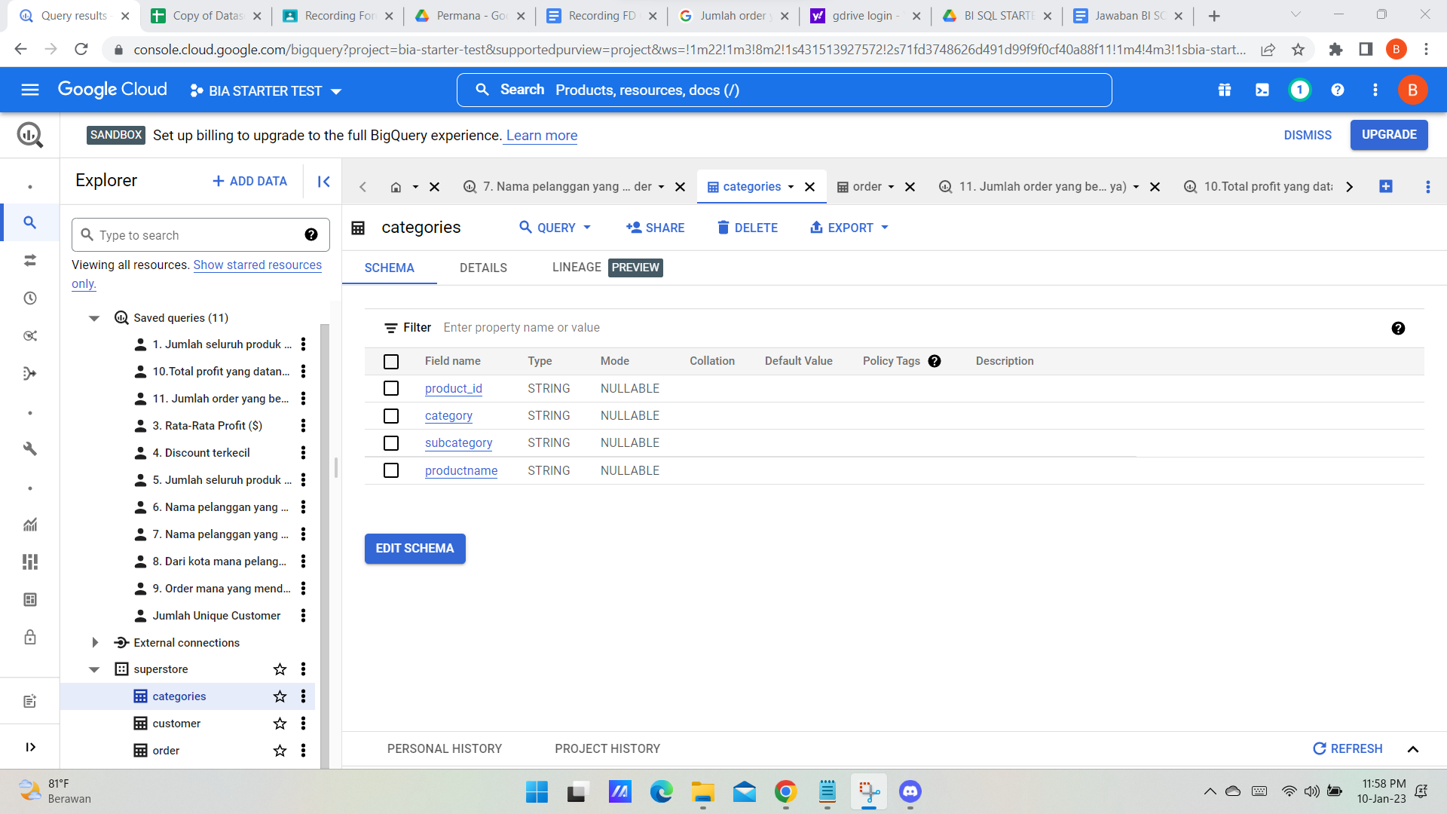
Tabel Categories

Slide 4
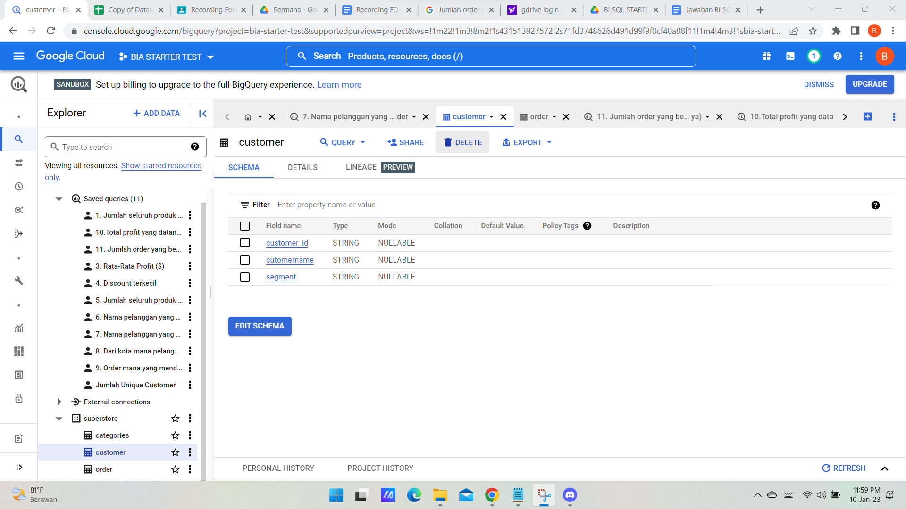
Tabel Customer

Slide 5
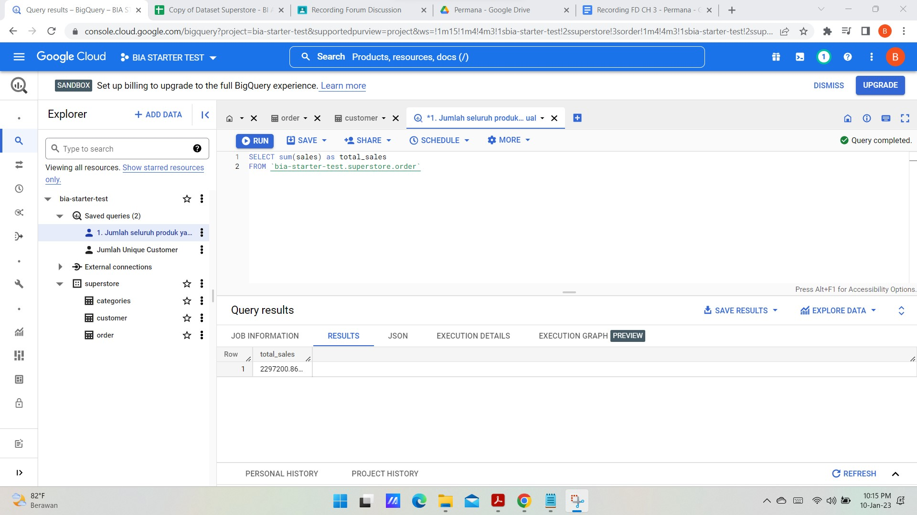
1. Jumlah seluruh produk yang terjual
SELECT sum(sales) as total_sales
FROM `bia-starter-test.superstore.order`

Slide 6
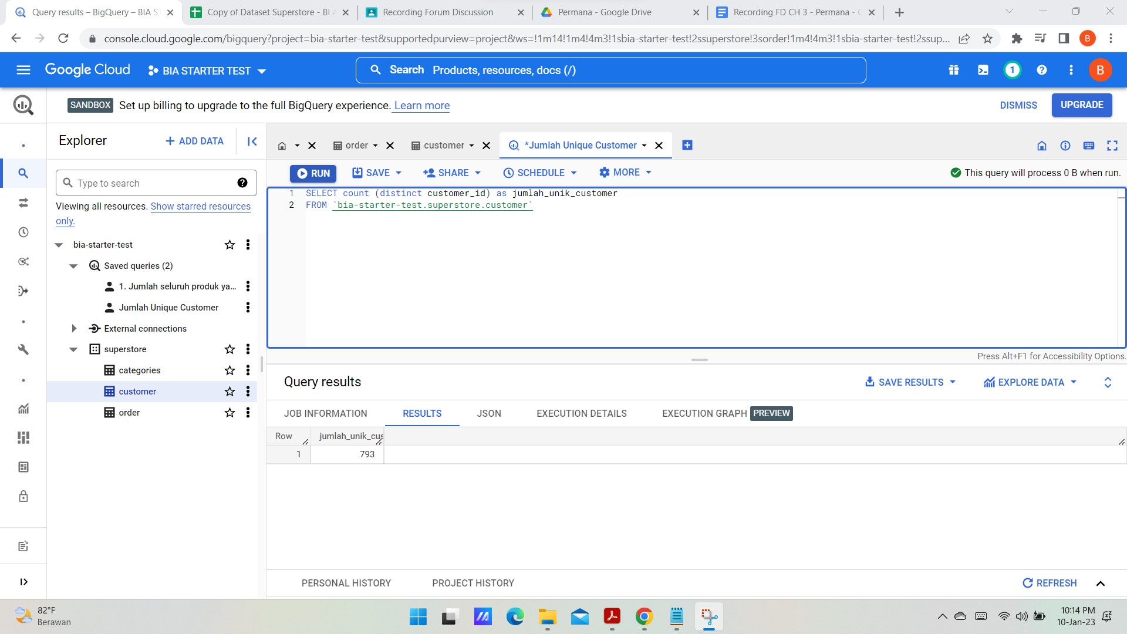
2. Jumlah unique customer yang telah memesan produk
SELECT count (distinct customer_id) as jumlah_unik_customer
FROM `bia-starter-test.superstore.customer`

Slide 7
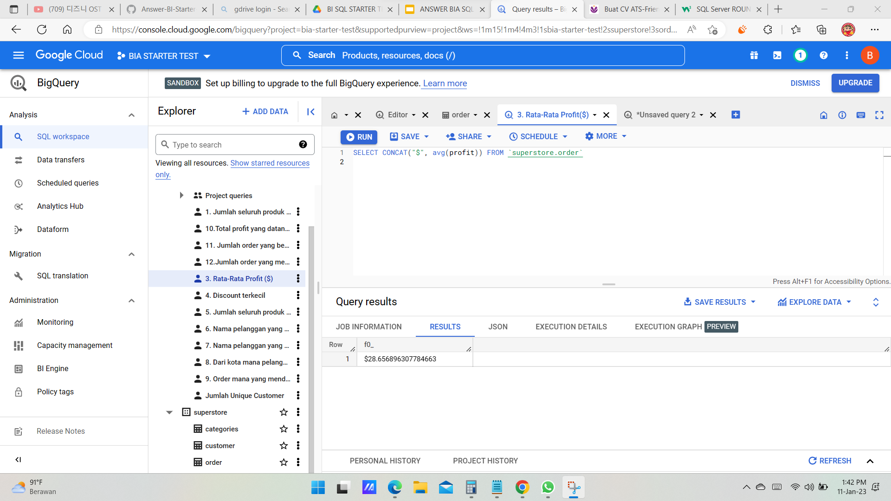
3. Rata-rata profit dari seluruh order (dalam mata uang)
SELECT CONCAT("$", avg(profit)) FROM `superstore.order`

Slide 8
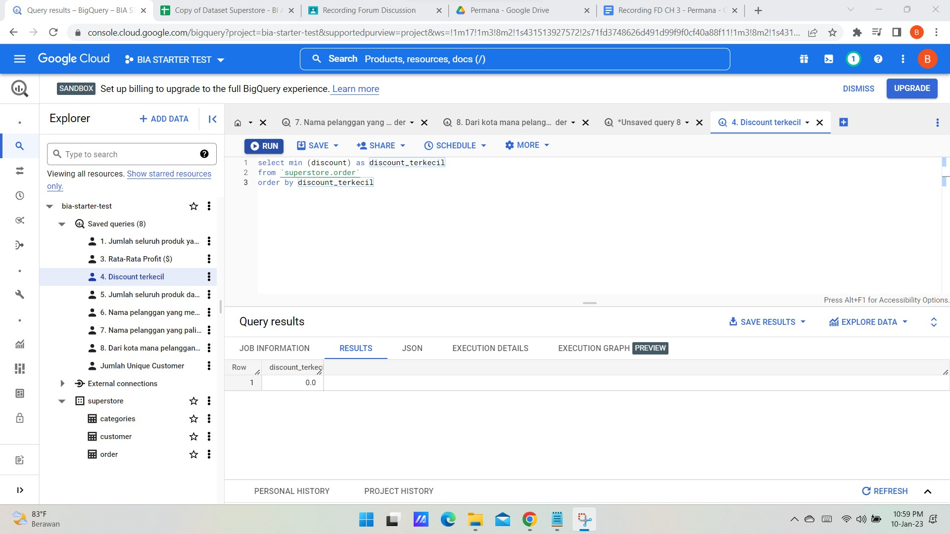
4. Berapa discount terkecil dari seluruh order
select min (discount) as discount_terkecil
from `superstore.order` order by discount_terkecil

Slide 9
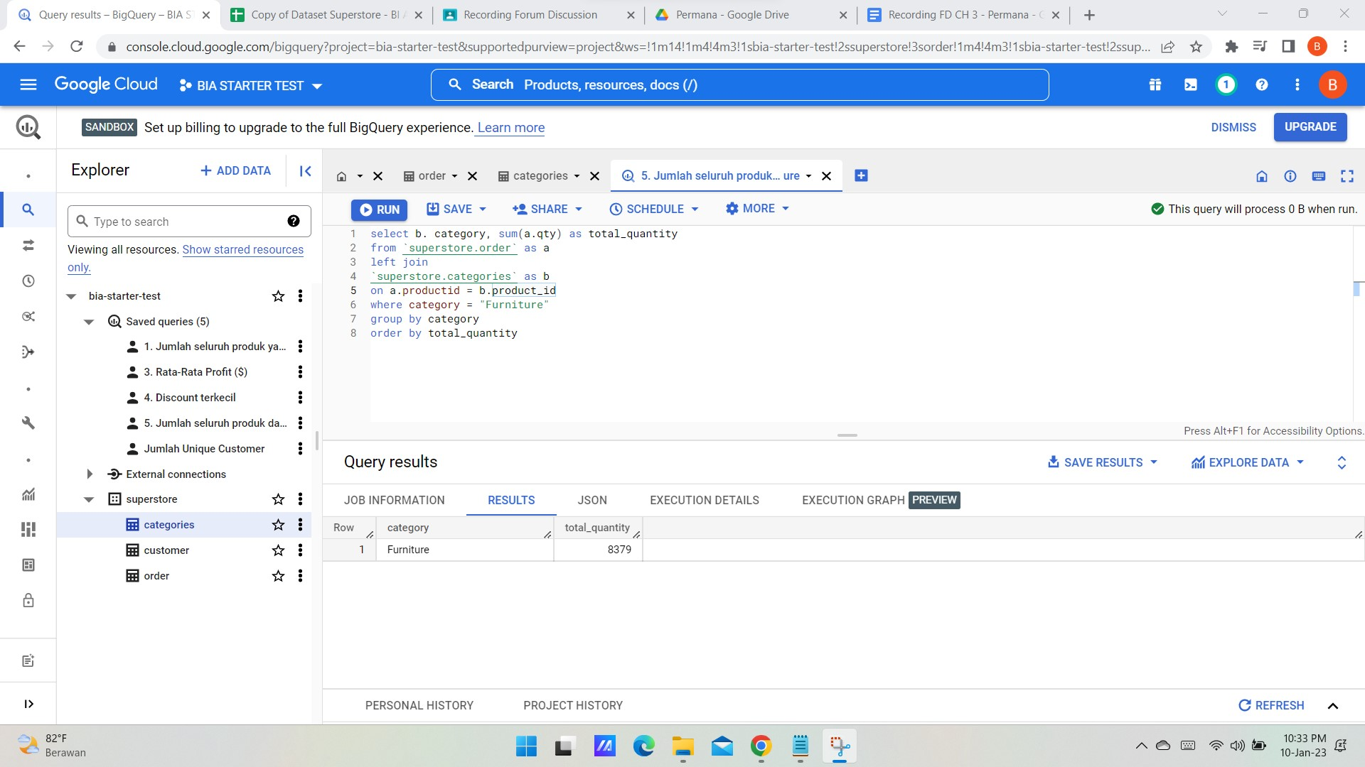
5. Jumlah seluruh produk dari kategori Furniture
select b. category, sum(a.qty) as total_quantity
from `superstore.order` as a
left join
`superstore.categories` as b
on a.productid = b.product_id
where category = "Furniture"
group by category
order by total_quantity

Slide 10
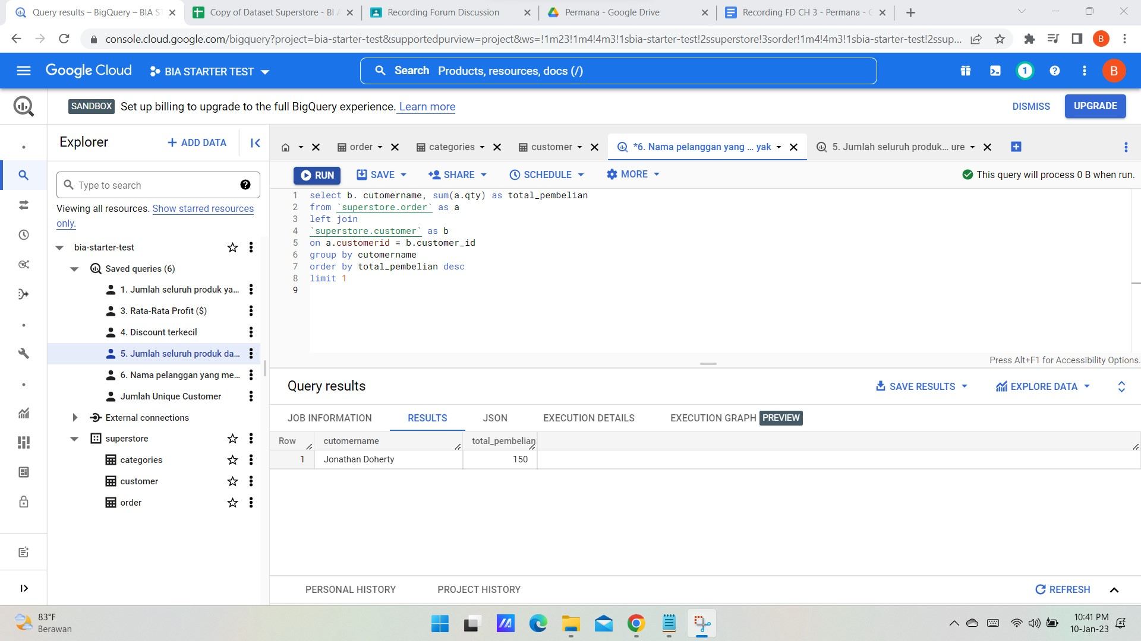
6. Nama pelanggan yang membeli produk paling banyak (dalam quantity)
select b. cutomername, sum(a.qty) as total_pembelian
from `superstore.order` as a
left join
`superstore.customer` as b
on a.customerid = b.customer_id
group by cutomername
order by total_pembelian desc
limit 1

Slide 11
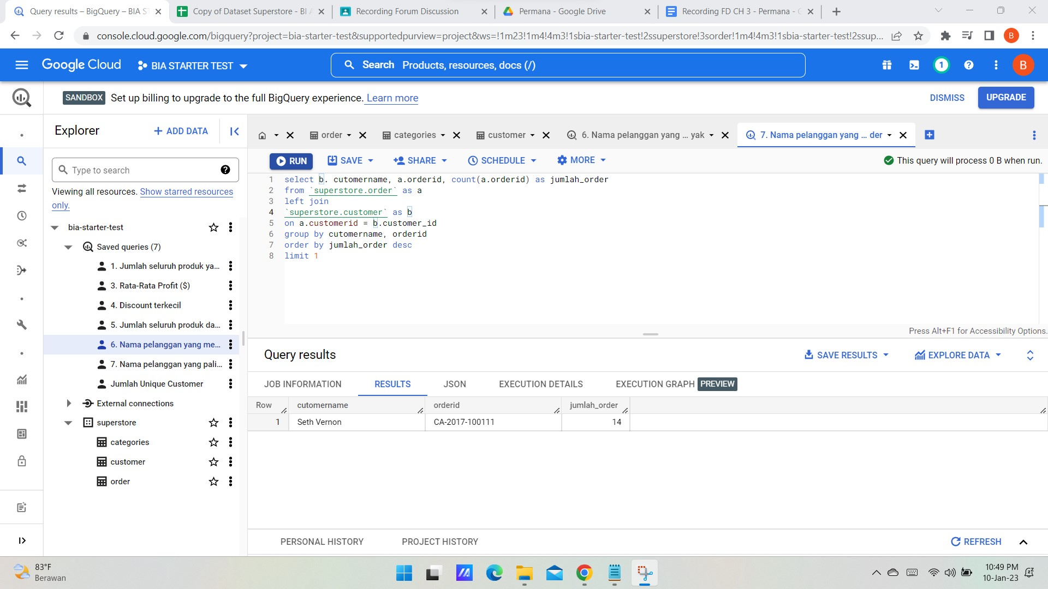
7. Nama pelanggan yang paling sering melakukan repeat order
select b. cutomername, a.orderid, count(a.orderid) as jumlah_order
from `superstore.order` as a
left join
`superstore.customer` as b
on a.customerid = b.customer_id
group by cutomername, orderid
order by jumlah_order desc
limit 1

Slide 12
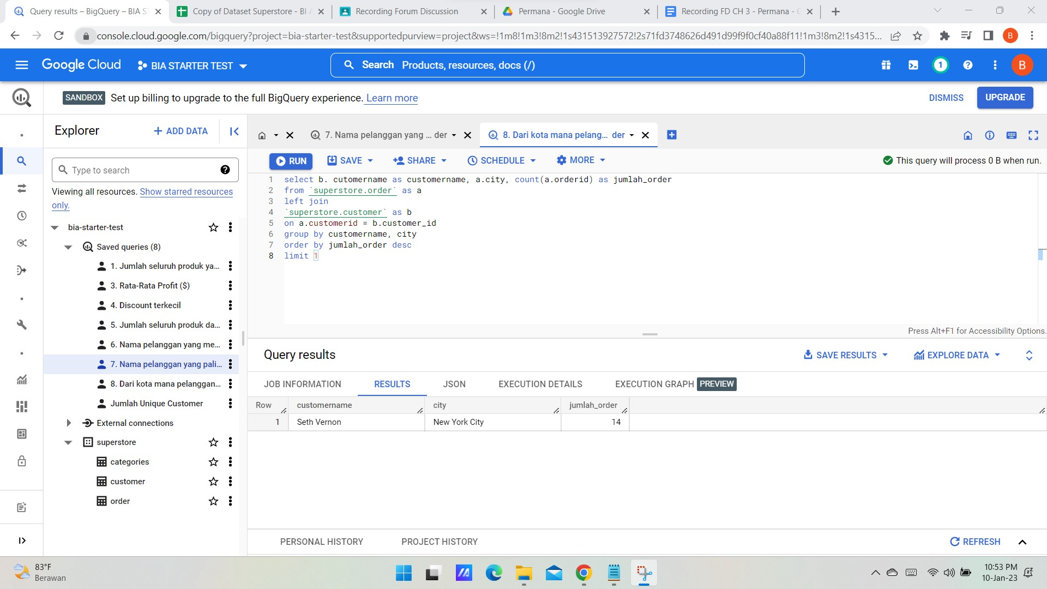
8. Dari kota mana pelanggan yang paling sering melakukan repeat order
select b. cutomername as customername, a.city, count(a.orderid) as jumlah_order
from `superstore.order` as a
left join
`superstore.customer` as b
on a.customerid = b.customer_id
group by customername, city
order by jumlah_order desc
limit 1

Slide 13
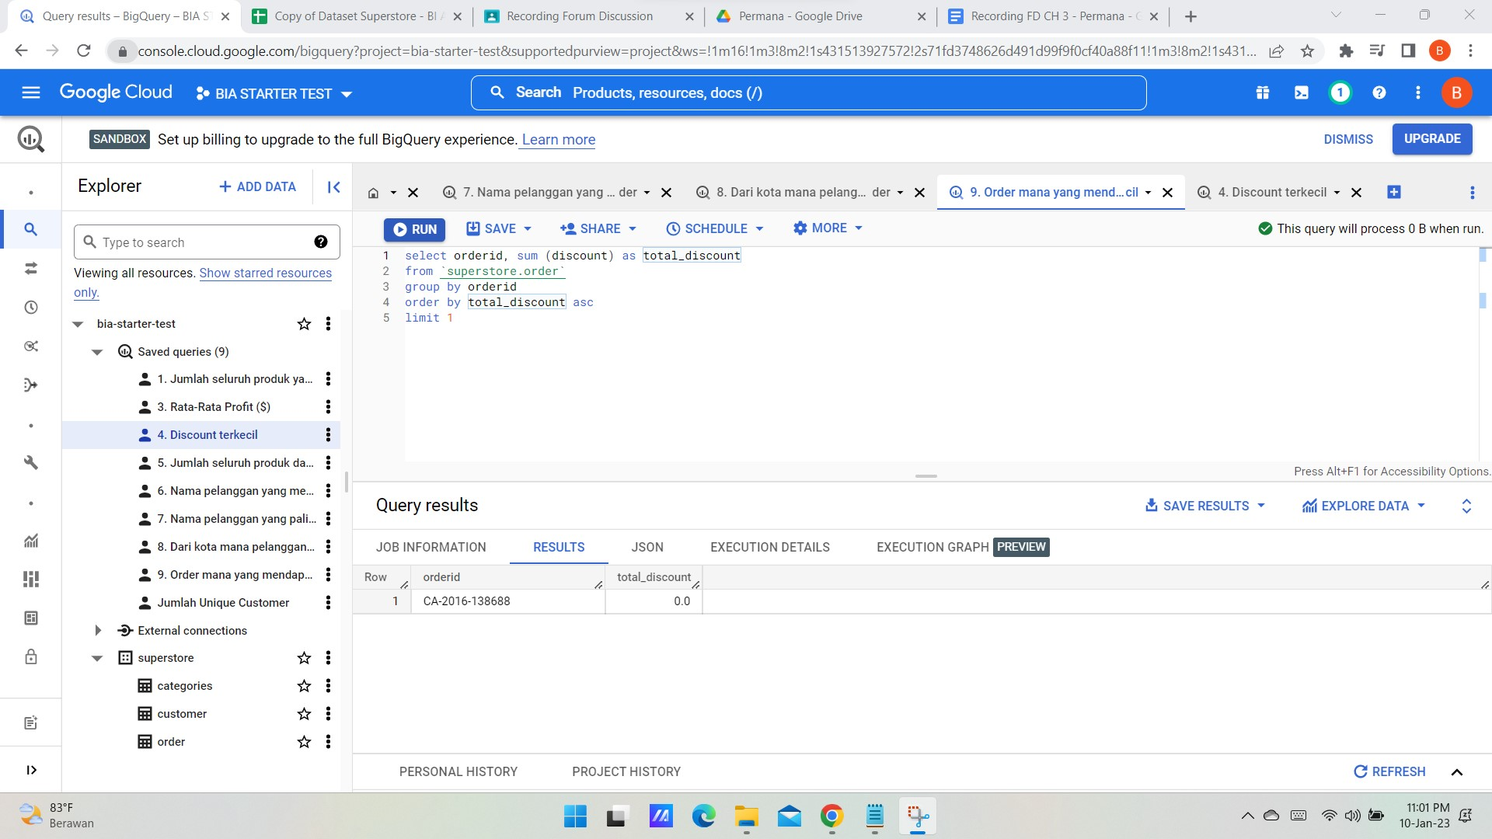
9. Order mana yang mendapatkan total discount paling kecil
select orderid, sum (discount) as total_discount
from `superstore.order`
group by orderid
order by total_discount asc
limit 1

Slide 14
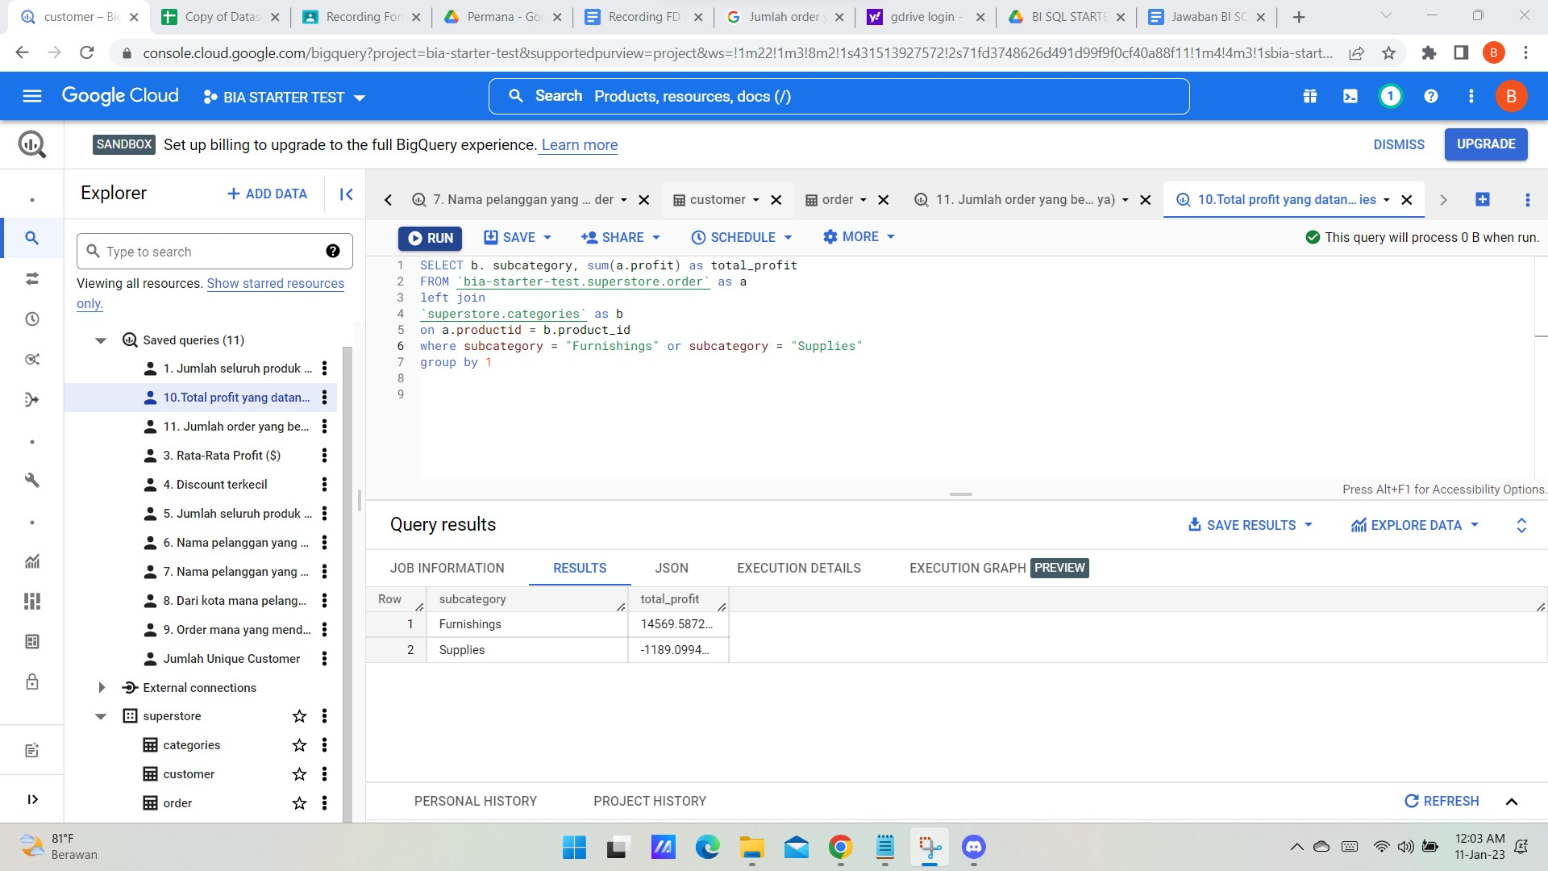
10.Total profit yang datang dari produk dengan sub category Furnishings & Supplies
SELECT b. subcategory, sum(a.profit) as total_profit
FROM `bia-starter-test.superstore.order` as a
left join
`superstore.categories` as b
on a.productid = b.product_id
where subcategory = "Furnishings" or subcategory = "Supplies"
group by 1

Slide 15
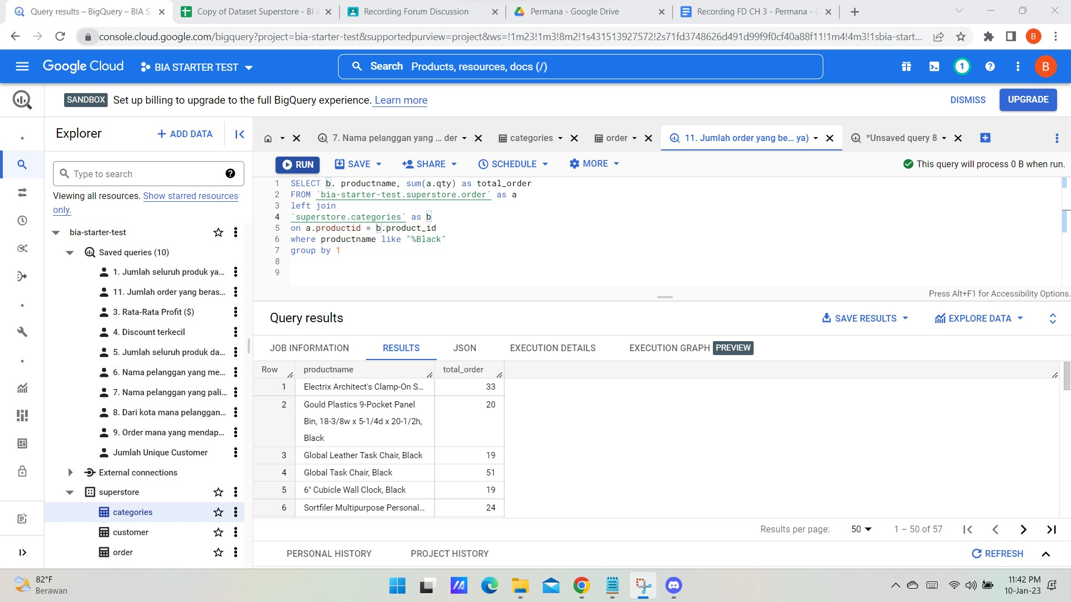
11. Jumlah order yang berasal dari produk warna hitam (terdapat keterangan “black” di nama produknya)
SELECT b. productname, sum(a.qty) as total_order
FROM `bia-starter-test.superstore.order` as a
left join
`superstore.categories` as b
on a.productid = b.product_id
where productname like "%Black"
group by 1

Slide 16
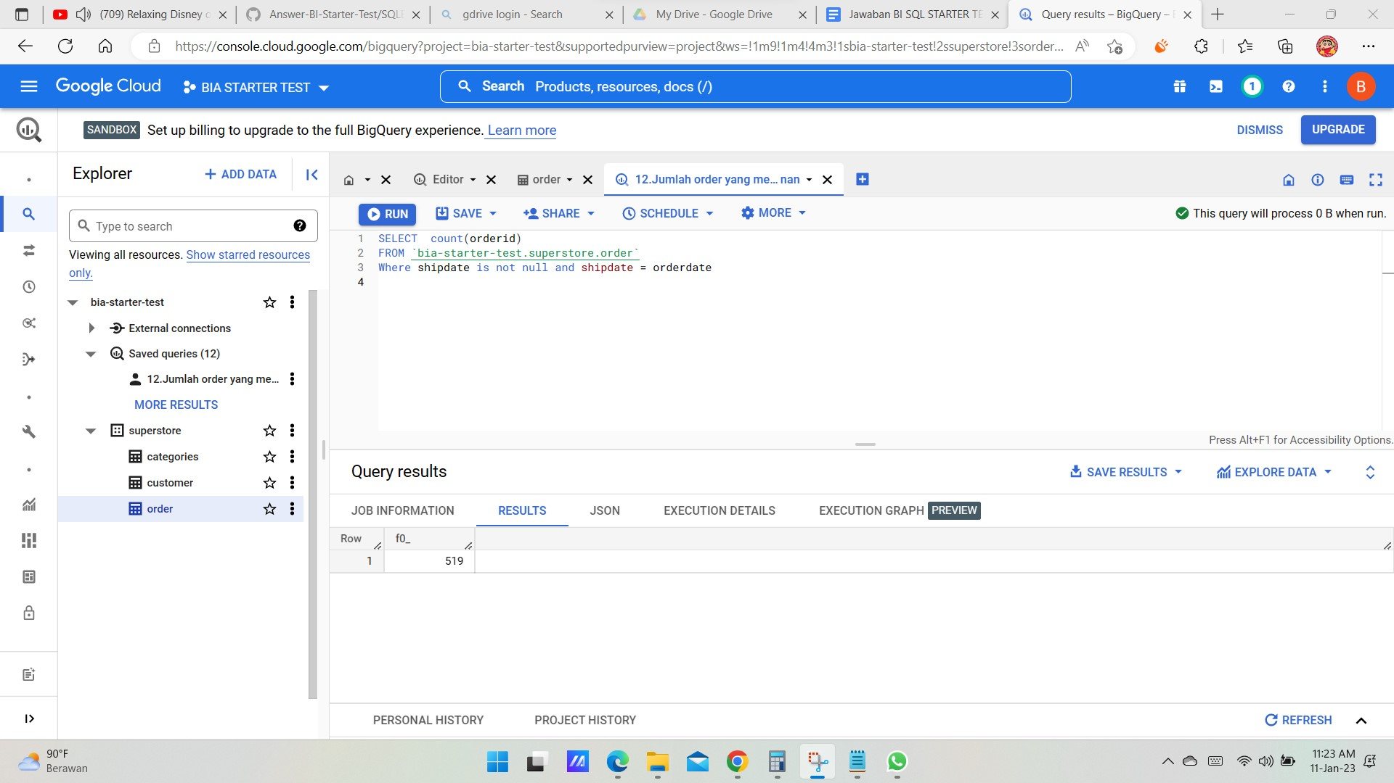
12.Jumlah order yang memiliki waktu pengiriman masih di hari yang sama dengan waktu pemesanan
SELECT count(orderid)
FROM `bia-starter-test.superstore.order`
Where shipdate is not null and shipdate = orderdate

Slide 17
SOAL BIE (OPTIONAL)
2. Select salary From employees
where department_id = "engineering"
order by 1 desc
limit 2
3. select name from users
where neighborhood_id = 0

